Slide 1
SALES MANAGEMENT SYSTEM
For Retails,
Textile Company
Notes:
This template can be used as a starter file to give updates for project milestones.
Sections
Right-click on a slide to add sections. Sections can help to organize your slides or facilitate collaboration between multiple authors.
Notes
Use the Notes section for delivery notes or to provide additional details for the audience. View these notes in Presentation View during your presentation.
Keep in mind the font size (important for accessibility, visibility, videotaping, and online production)
Coordinated colors
Pay particular attention to the graphs, charts, and text boxes.
Consider that attendees will print in black and white or grayscale. Run a test print to make sure your colors work when printed in pure black and white and grayscale.
Graphics, tables, and graphs
Keep it simple: If possible, use consistent, non-distracting styles and colors.
Label all graphs and tables.

Slide 2
it scholarship EmConsultant.
Md. Moshaidul Islam
wdpf.idb-bisew it scholarship Email: moshaidul@gmail.com
idul@gmail.com
Supervisor & Coordinator.
Instructor: Farhana akter Lucky wdpf.idb-bisew it scholarship Email:farhanawdpf@gmail.com
Developed By.
Name:
Trainee ID: Batch: WDPF/ Email:

Slide 3
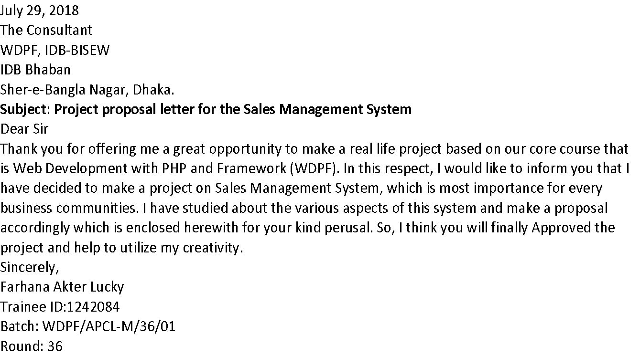
Application

Slide 4
Index of the project
Project Background and Objective -------------------------5
Software Features and Scope -------------------------------- 6
ERD Diagram ------------------------------------------------------ 7
List Of Reports ---------------------------------------------------- 8
Product Registration Forms--------------------------------------9
Sales Invoice Form-----------------------------------------------10
Example of Invoice Report---------------------------------------11
Milestone/Timeline -------------------------------------------- 12
Information Source & Reference ---------------------------- 13
Use Of Tools And Technology -------------------------------- 14
Implementation Cost ------------------------------------------ 15
Critical Review --------------------------------------------------- 16
Future Plan ------------------------------------------------------- 17

Slide 5
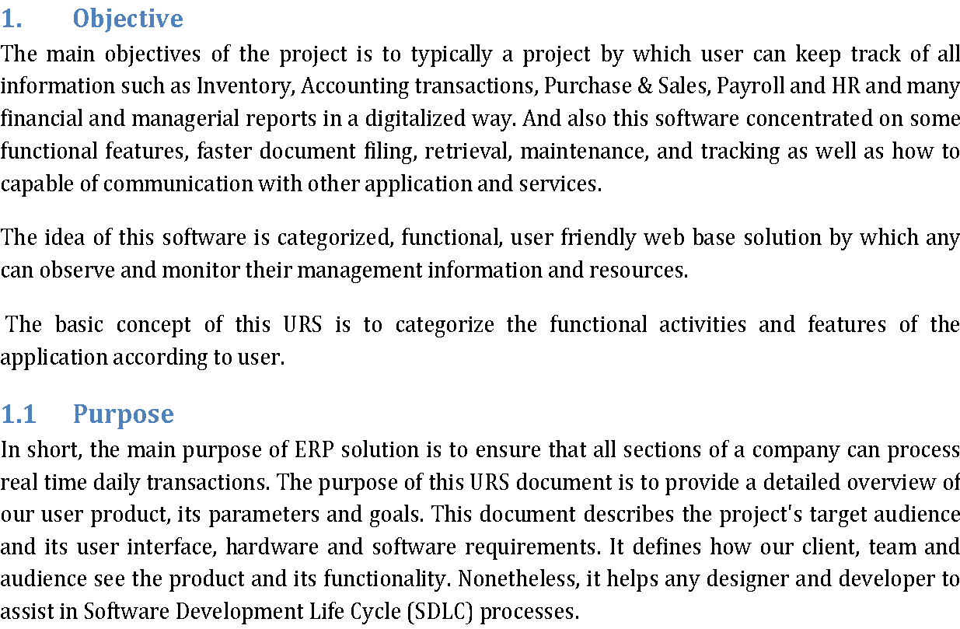

Slide 6
Software Features
Audit information system.
Flexible purchase and sales report.
Flexible dues calculation.
Product price life cycle report.
Sales analysis report.
Current stock and assets report of the shop
Online report system.
Repots with graphical view.
communicate by text and calling one to another user.
Auto backup Database.
Safe from Hacker and third parties.
Different login system
Controlling Access to perform specific task.
Control product by type, category and manufacture base.
Product Expired date notification.
Stock Management system.
Lot Base Product Stock.
FIFO and LIFO Sales system.
Multiple unit of measurement base sales.
Product price and discount system.
Tax control system.

Slide 7
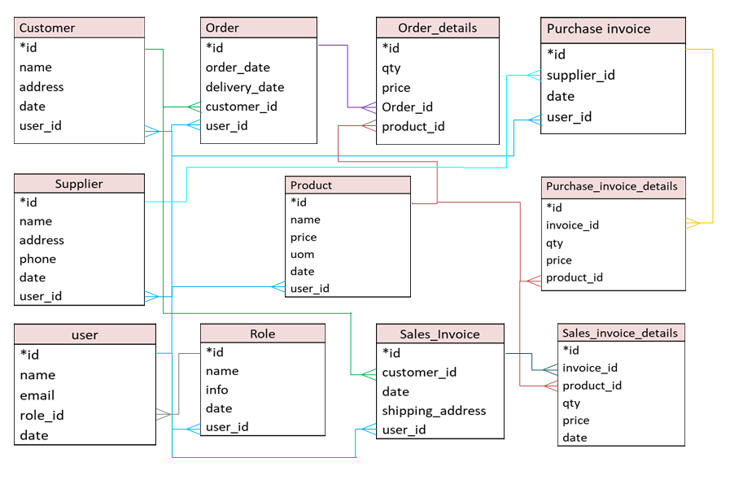
ERD - Entity Relationship Diagrams

Slide 8
List Of Reports
Designation Report
Employee Report
Product Type Report
Product Category Report
Purchase Report
Stock Report
Wastage Report
Expired Date Report
Sales Report
Profit and Benefit
Order Report
Received Report
User Report
Audit Report
Menu Form
Password Form

Slide 9
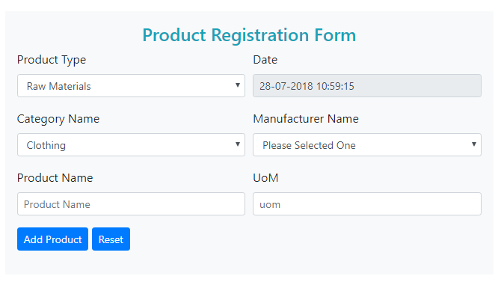
Product Registration Forms

Slide 10
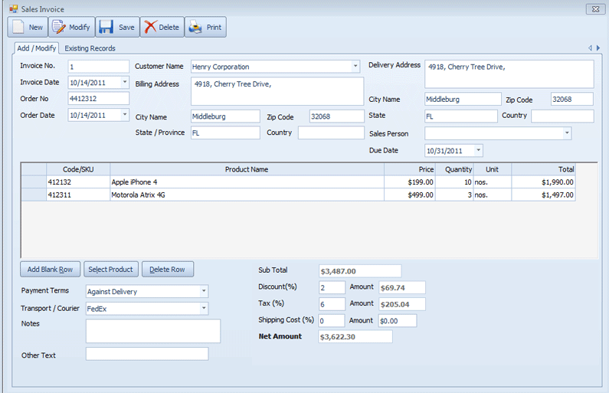
Sales Invoice Form

Slide 11
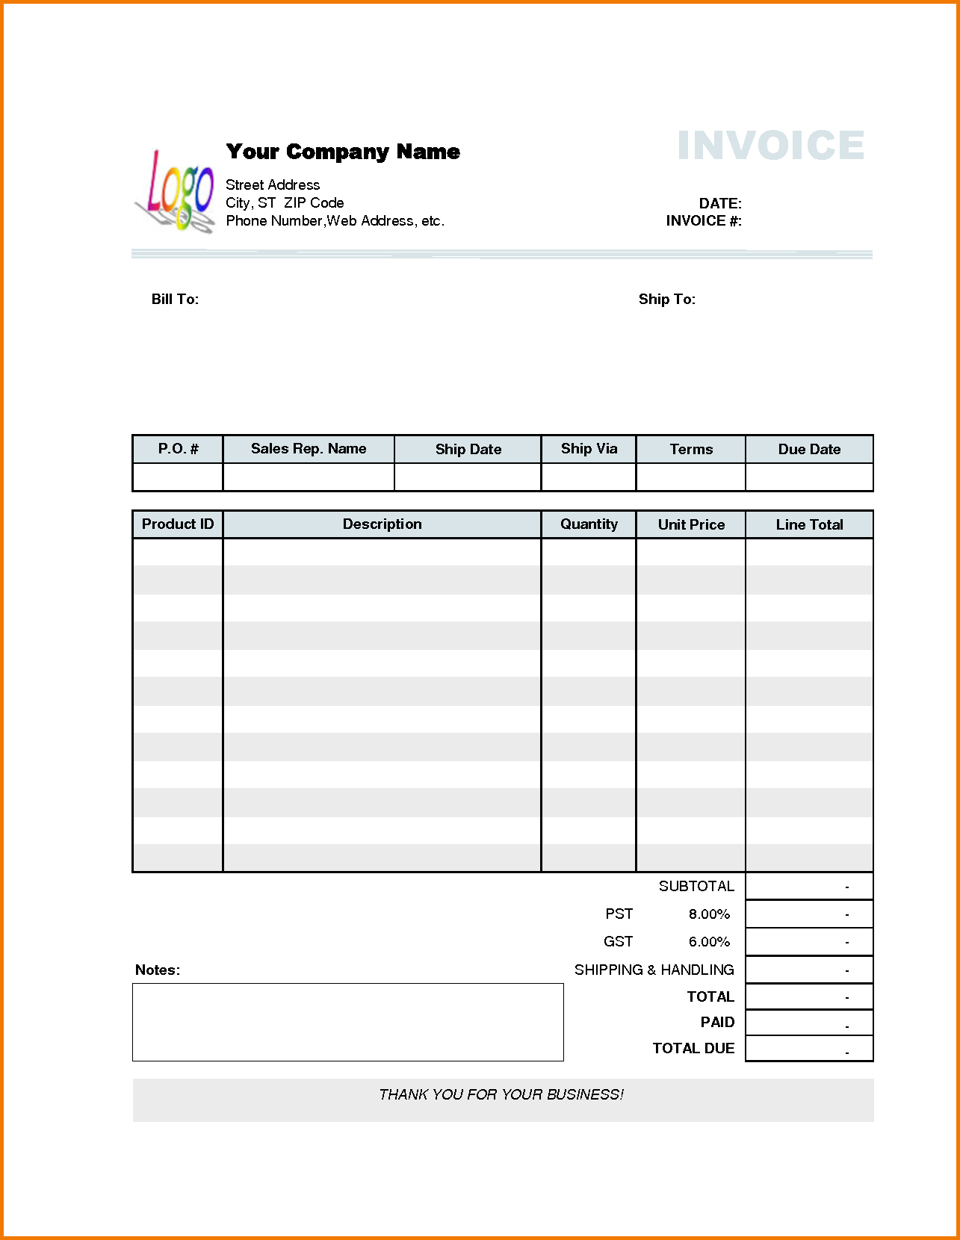
Example of Invoice Report

Slide 12
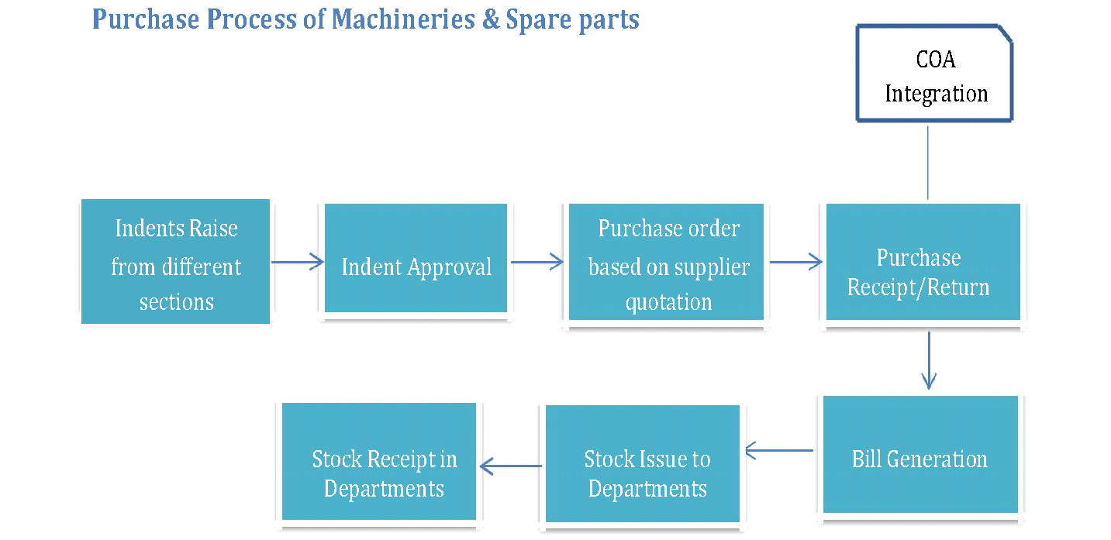

Slide 13
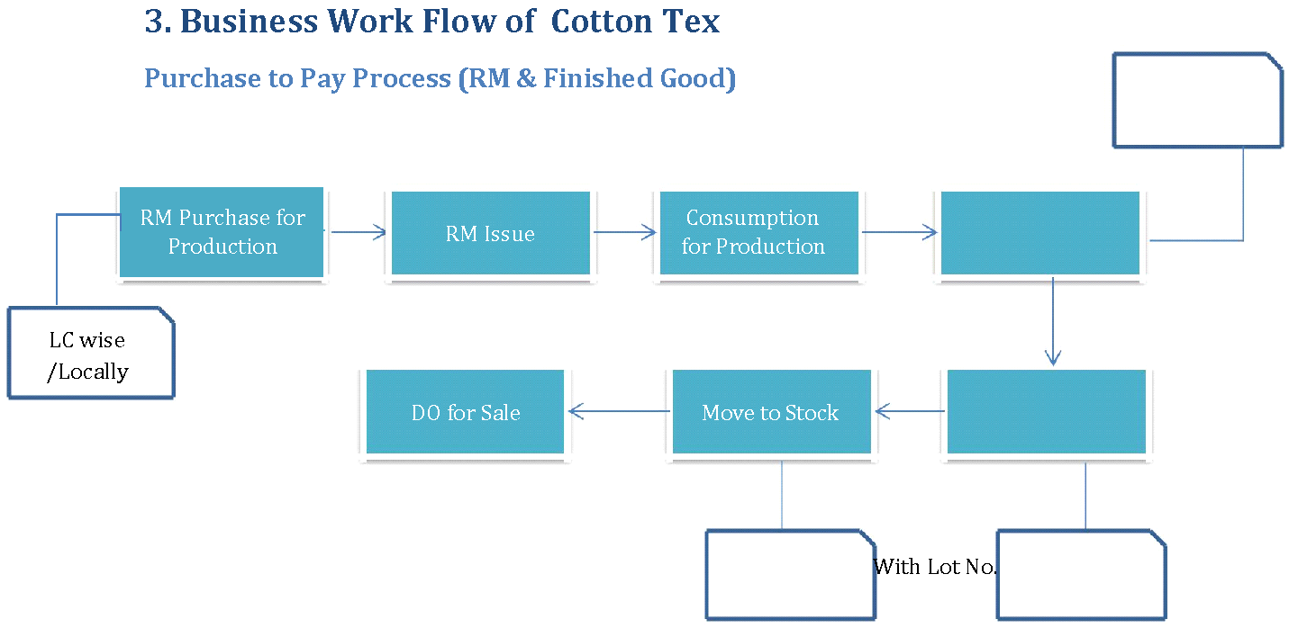

Slide 14
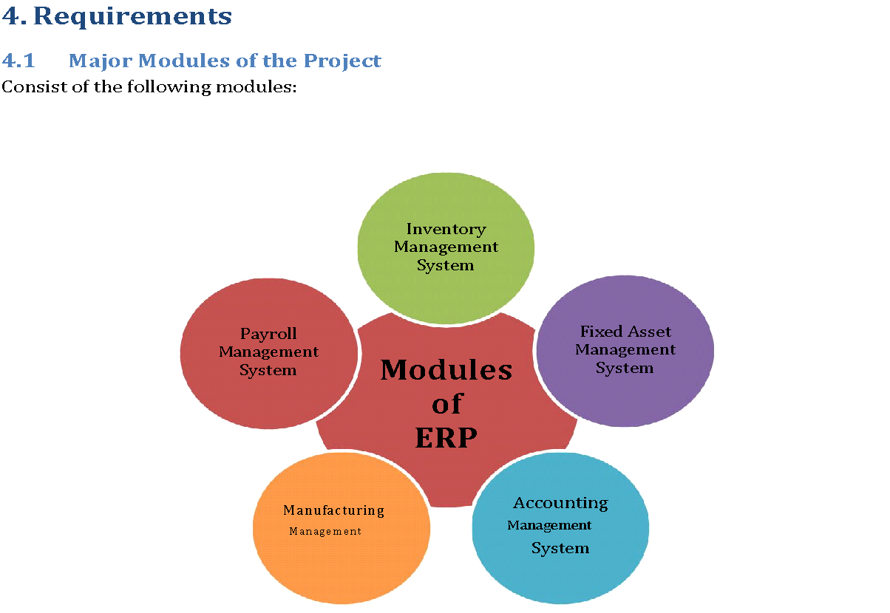
Figure: Modules of ERP

Slide 15
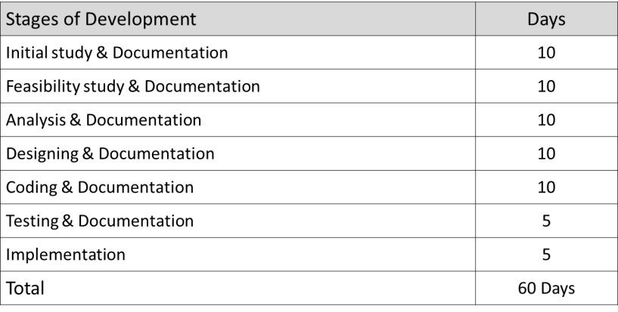
Milestone/Timeline

Slide 16
Information Source & Reference
PHP.Net
MySql.com
Vcampus
W3School
Income Tax Authority
Audit Information
Supply chain management
Stock Management
Bar Council
Ministry of Law
Wikipedia
Legal Aid

Slide 17
Use Of Tools And Technology
This is a web based software and can be run either offline or online or both systems. It is based on frontend and backend system.
Frontend | Html 5, CSS3, Bootstrap, JavaScript
Back end | PHP, MYSQL
Server Software Configuration
Operating System | Windows 7 and higher
Language | PHP
Database | MYSQL
Operating System | Windows 7 and higher
Server Hardware Configuration
Processor | Intel(R) Core(TM) 2Duo CPU @ 2.93 GHZ
RAM | 2 GB
Hard Disk Drive | 20 GB
Keyboard | 122 Keys

Slide 18
Implementation Cost
The implementation will cover the following areas:
Analysis of Super Shop management system.
Core coding of the application.
Database designing.
Frontend design.
Developing the business and database logic.
Module level unit testing.
Bug fixing and final release including server setup

Slide 19
Future Plan
The future plan of this project software to improve its features and user friendly interface and also more flexible. Some of Future plan are listed below.
More user flexibility.
Reports are Diagram base.
Security Improvement.
Full responsive design.
Bug fixing and improve speed.
Online Order and payment system.
Communication Improvement.

Slide 20

Thanks For Watching

